Slide 1
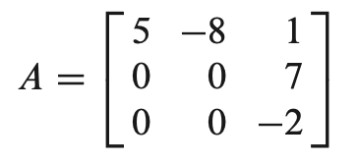
Latihan Soal EAS
Tentukan eigenvalues dan eigenvector dari
Matrik
Matrik
Matrik
Show that the matrix is diagonalizable.
Find a diagonal matrix D that is similar to A.
Determine the similarity transformation that diagonalizes A.

Slide 2
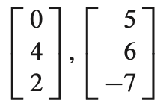
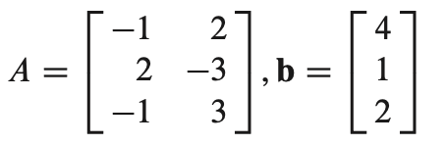
Latihan Soal EAS
3. Use the Gram–Schmidt process to produce an orthogonal basis for W
4. Let find the a least-squares solution of Ax = b

